Slide 1
Name: Swapnil Ghosh
Dept: IT
Roll No: 001911001067
PROGRAM 5

Slide 2
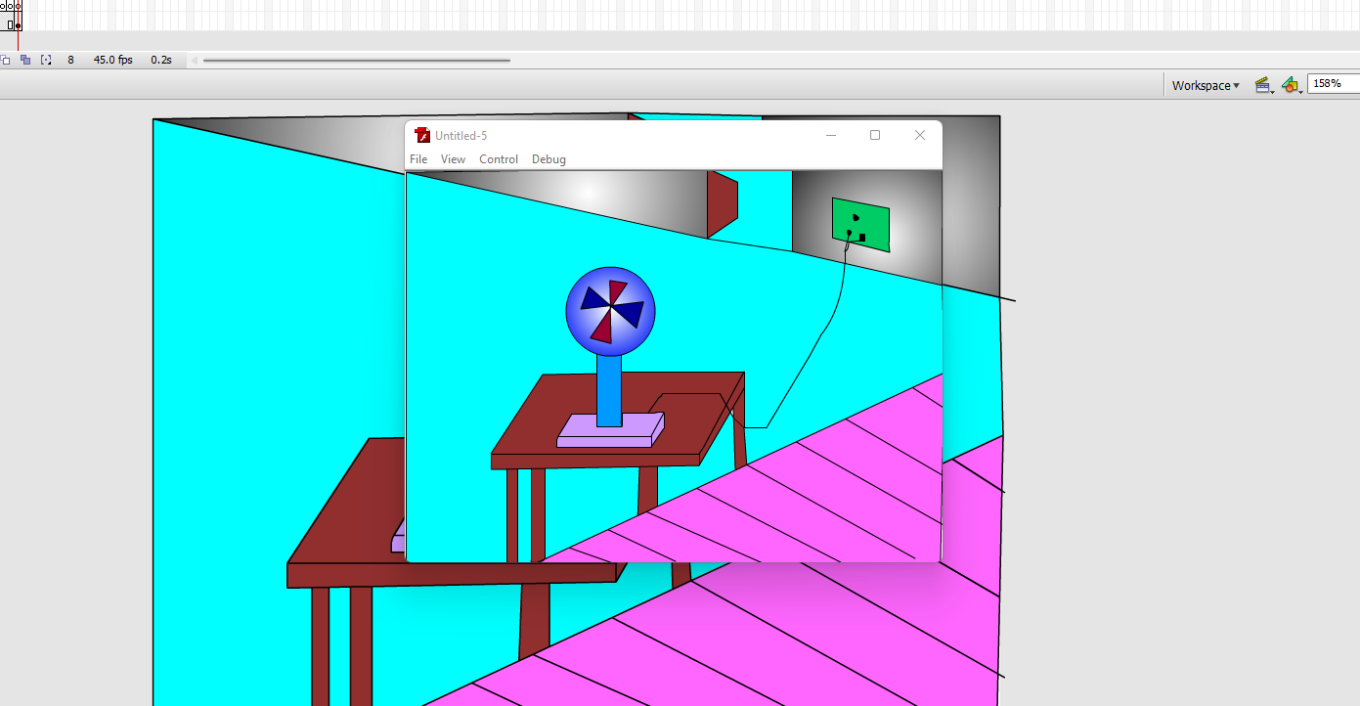
go to start-> macromedia-> click on flash document.
2. Create a background on layer 1.
3. Insert another layer-> draw only fan blades and its circle.
4. Insert another layer and draw fan stand.
5. On each layer right click on frames and insert key frames.
6. Select the fan blade’s layer and insert new key frame-> select the fan blades by free transform tool and rotate the circle a little bit.
7. repeat the rotation until you get the fan rotation animation.
8. Go to control->test movie to see the animation.

Slide 3
